Slide 1


Image Captioning with Keras
Università degli Studi di Salerno
Facoltà di Scienze MM. FF. NN.
Dipartimento di Informatica
Context Aware Security Analitycs for Computer Vision
Salvatore Arienzo 052250476

Slide 2

What?

Slide 3
Why?
Social Networks
Blind People
Security Cameras

Slide 4


Dataset

Slide 5
Data Preprocessing
Starting token

Slide 6
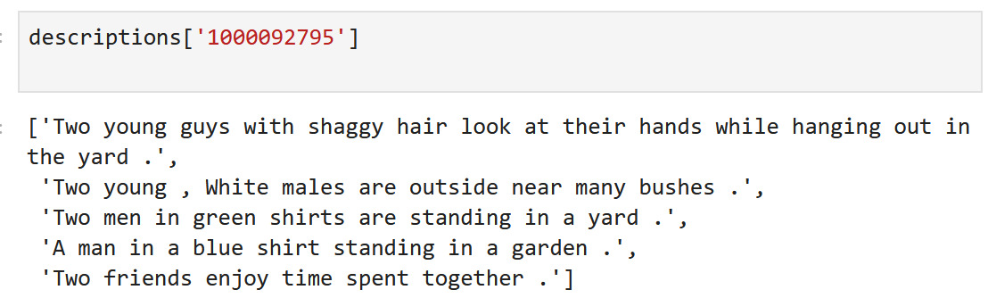
Data Preprocessing
- Descriptions

Slide 7
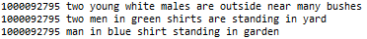
Data Preprocessing
- Data Cleaning and Splitting

Slide 8
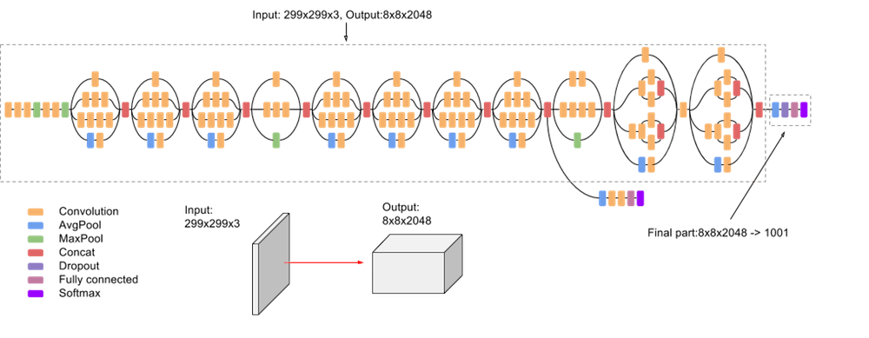
CNN – Inception Model

Slide 9
Word Embeddings
- 200-vector - One hot encoding
[‘Hello’, ‘World’] -> [1,0],[0,1]
- Embedding Matrix: (7640, 200) (vocabulary size, vector dimension)

Slide 10
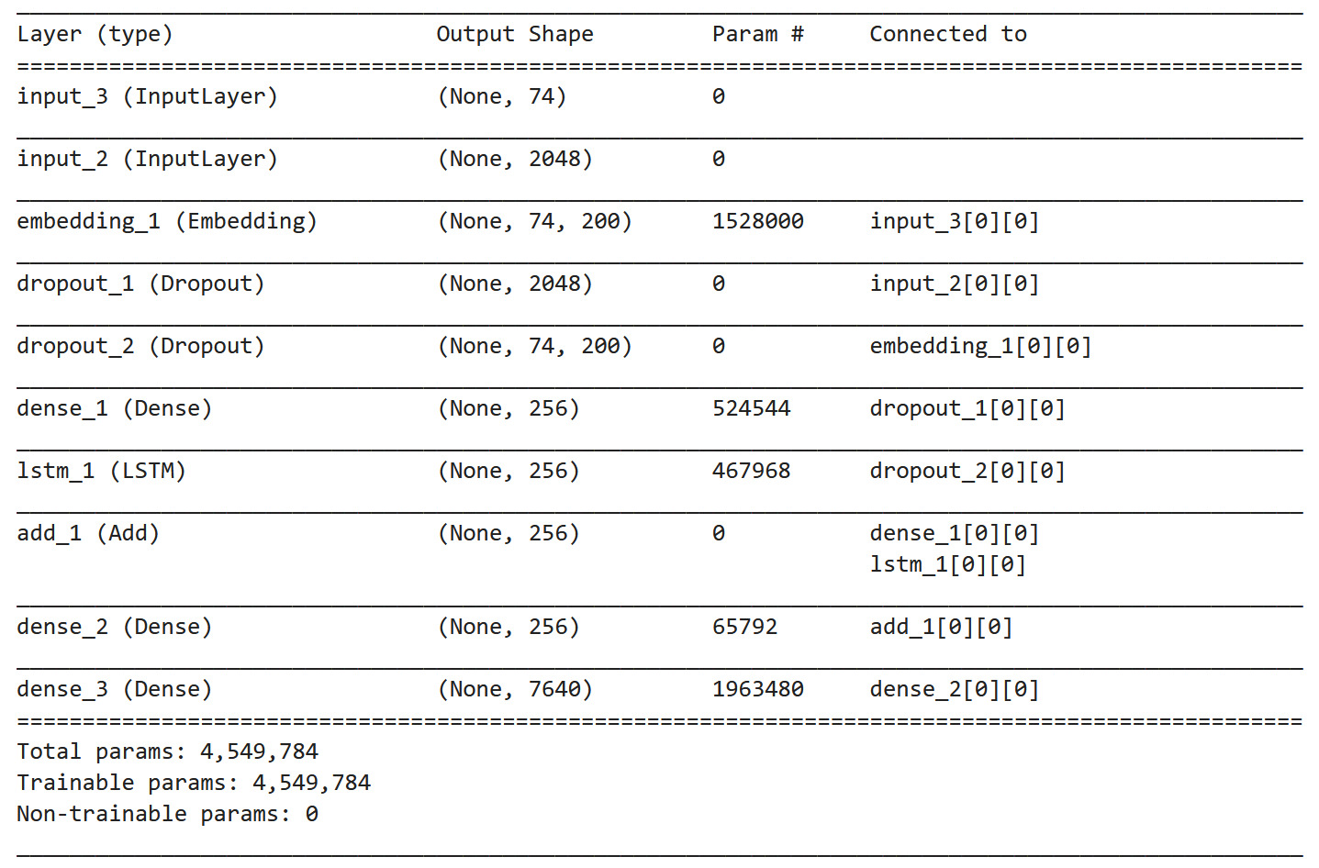
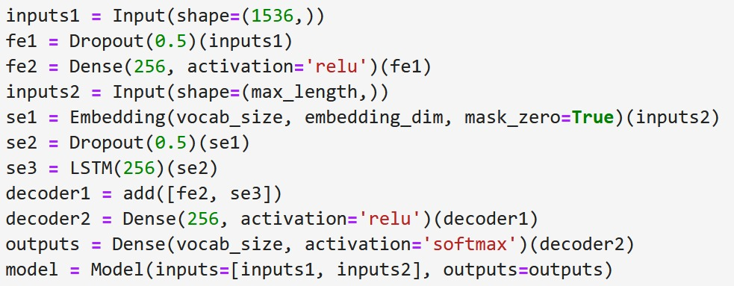
RNN
Notes:
In this case, the recurrent neural network is used
as a text generation model. Our model takes
as input, both the images vectors and the par-
tial captions (input layer 1 and 2), than in the
embedding layer, every index of the captions is
mapped to a 200 dimensional vector. Then we
have two dropout layers, to try to avoid over-tting.
Then we add some Dense (for image
model) and LSTM (For caption model) LSTM,
Long Short Term Memory, is a specialized Re-
current Neural Network that processes not only
single data point, like images, but also entire se-
quences of data(like speech or text). The nal
output layer, that uses a softmax activation, will
give us the probability distribution across the
7640 words of the vocabulary.

Slide 11
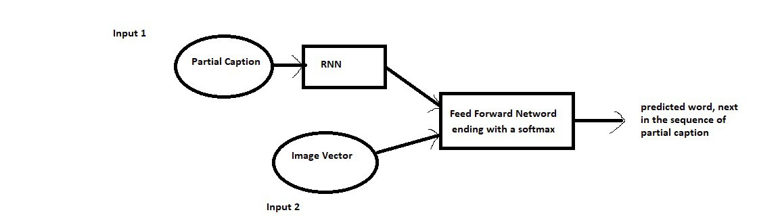
RNN
Notes:
In this case, the recurrent neural network is used
as a text generation model. Our model takes
as input, both the images vectors and the par-
tial captions (input layer 1 and 2), than in the
embedding layer, every index of the captions is
mapped to a 200 dimensional vector. Then we
have two dropout layers, to try to avoid over-tting.
Then we add some Dense (for image
model) and LSTM (For caption model) LSTM,
Long Short Term Memory, is a specialized Re-
current Neural Network that processes not only
single data point, like images, but also entire se-
quences of data(like speech or text). The nal
output layer, that uses a softmax activation, will
give us the probability distribution across the
7640 words of the vocabulary.

Slide 12
Evaluation
Not decidible
BLEU (Bilingual evaluation understudy)
['this','is','a','caption] – ['this','is','a','caption]
Custom Score
[‘Man’, ‘doing’,’jogging’]
[‘Man’, ‘running’,’over’,’street’]

Slide 13
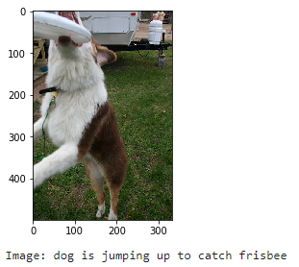
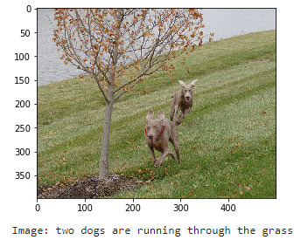
Conclusions - Results

Slide 14
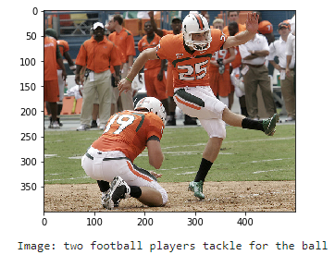
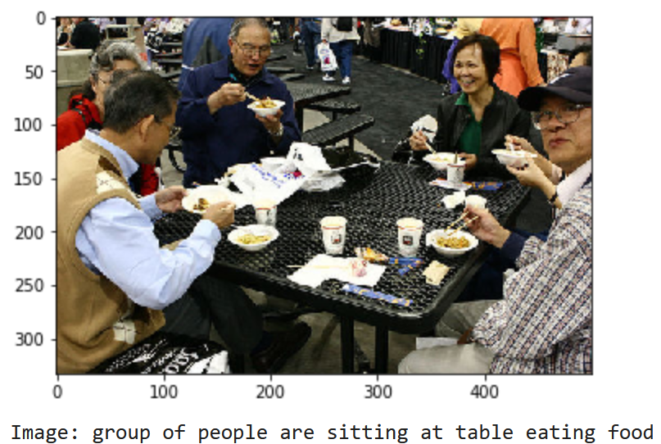
Conclusions - Results

Slide 15
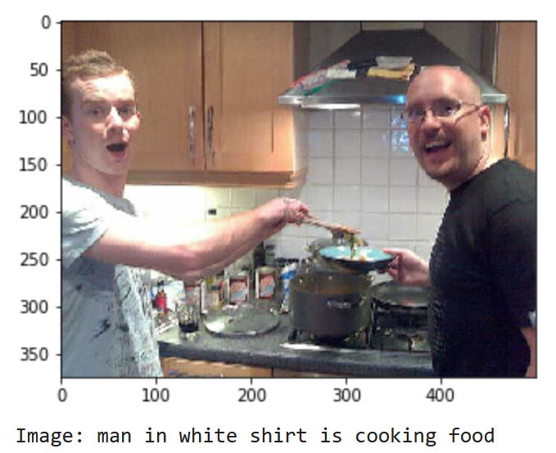
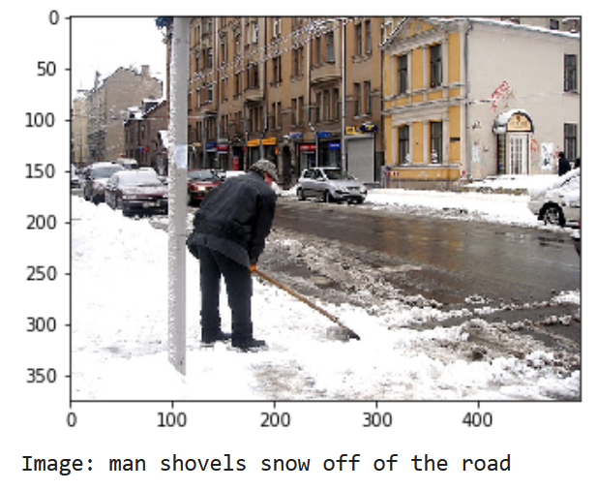
Conclusions - Results

Slide 16
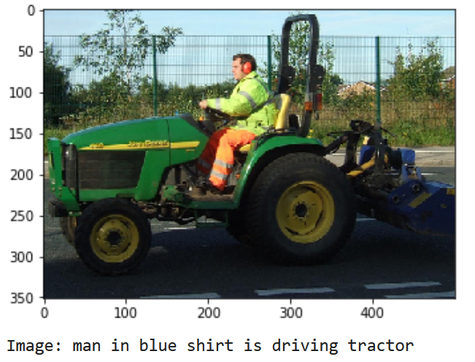
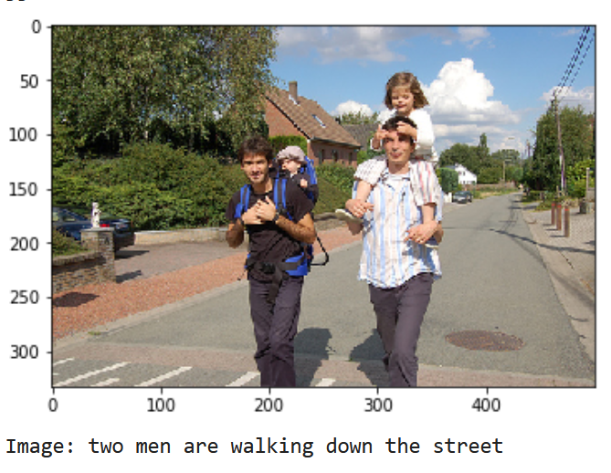
Conclusions - Results

Slide 17
Thank you!

